Slide 1


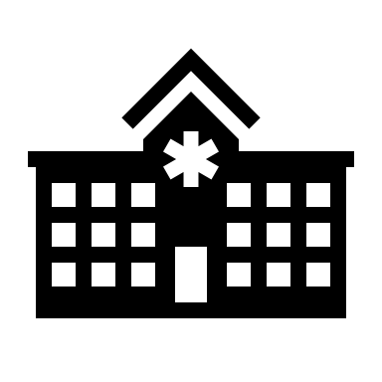

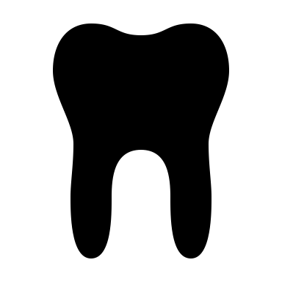
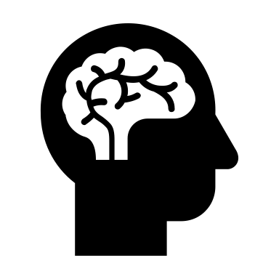

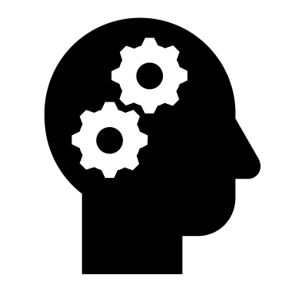
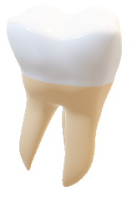
Improve your clinical skills
Pass the CSCT: to be able to practise dentistry
You can pass the exam to enter clinical internship if you want to specialise in :
  Oral surgery
  Orthodontics
  Oral medicine
During this year : you must work hard to pass through the selection ! It’s basically the « no life year » but it’s worth it !!!
Very important year:
last preclinical year: get ready for the clinic
more theoretical courses than practical works
a month of job shadowing
Paces
2nd y
5th y
6th
3rd y
4th y
Congratulation you succeeded the PACES : welcome in Reims!
Discover the student life and the dentistry world
Develop our hand skills: so many practical works
Welcome to the clinic!
You now have many responsibilities : we take care of actual patients
You gonna work with your partner (in crime)
But you still have courses and practical works at the uni
Only clinical work
No more courses and practical work at the uni but you can help teacher in practical works

Slide 2
Embryology:
- 2 hours a week: teeth’s development
- 6 hours / semester of practical work: recognizing and drawing embryological structure with microscope
Operative Restorations:
- 3 hours / week
- 4 hours of PW / week: making ≠ types of cavities to do amalgam and composite obturations
Physiology:
- 2 hours a week: studying function of ≠ physiological systems (respiratory, digestive systems)
Biomaterials:
- 2 hours a week
- learning how to use necessary biomaterials in dentistry (dental impression, articulator)
1st semester
Phylogeny:
- 2 hours a week: study of the face’s development
Fixed prosthodontics:
- 1 hour a week (e learning courses)
- 2 hours of practical work each week: learning to use instruments, doing peripheral coronary preparation and resin crowns
Microbiology:
- 1 hour a week: description of virus, bacteria in the mouth
Removable prosthodontics:
- 1 hour a week
- 2 hours of practical work each week: we have an imaginary patient and we have to reconstruct his dental anatomy with removable prosthodontics
Dental anatomy:
- Recognizing natural teeth during practical work
- Sculpture of a plaster tooth (one of each type)
- E-learning courses (1h/week)
Occlusodontics:
- E learning courses: studying the jaw movements and functions
Immunology:
- 2 hours a week: same courses as medical student, studying of the immune system
Operative Restorations:
- 1 hours / week
- 4 hours of PW / week: making ≠ types of cavities to do amalgam and composite obturations
Fixed prosthodontics:
- 1 hour a week (e learning courses)
- 2 hours of practical work each week: learning to use instruments, doing peripheral coronary preparation and resin crowns
2nd semester
Histology:
- 2 hours a week: studying different oral tissues
- 6 hours / semester of practical work: recognizing and drawing histological structures with microscope
Orofacial growth:
- 1 hours/ week
- growth time-line, dental and oro-facial growth
Dental anatomy:
- 2 hours of practical work/ week : “Wax up” teeth reconstruction
Medical pathology:
- 1’30 hours / week
- discover the diseases of the human body’s systems like heart device, pulmonology, endocrinology and neurological
Biomaterials:
- 2 hours a week
- Following the same things we study during the 1st semester
English:
- 2 hours/ week
- studying pronunciation, dentistry-related anatomy and dentist’s work environment
Medical imagery:
- 1 hours / week
- studying how X-rays work and how we get a panoramic of the oral cavity
Semiology:
1’30 hour/week
studying symptom and clinical signs

